Slide 1
AEM & AEM as a Cloud Service (AEMaaCS)
Architecture Overview

Slide 2
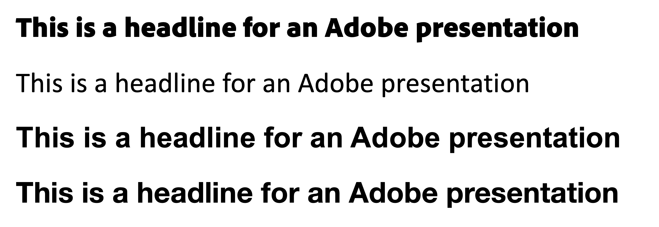

Read before proceeding
An important note about fonts:
This template uses weights of Adobe Clean that you may not have on your system.
The following editable text:
This is a headline for an Adobe presentation
Adobe Clean Black
Before using this presentation template, please familiarize yourself with our Adobe brand guidelines, located in Brand Center on Inside Adobe.
Should look like this screenshot:
Adobe Clean Black
Not like any of these:
Calibri
Arial Bold (Windows)
Helvetica Bold (Mac)
If you're seeing anything other than Adobe Clean, or to ensure you have the latest set of fonts, visit Brand Center. https://inside.corp.adobe.com/brand-center/font.html
For additional help Contact brand@adobe.com if you have questions about using this PowerPoint template.

Slide 3
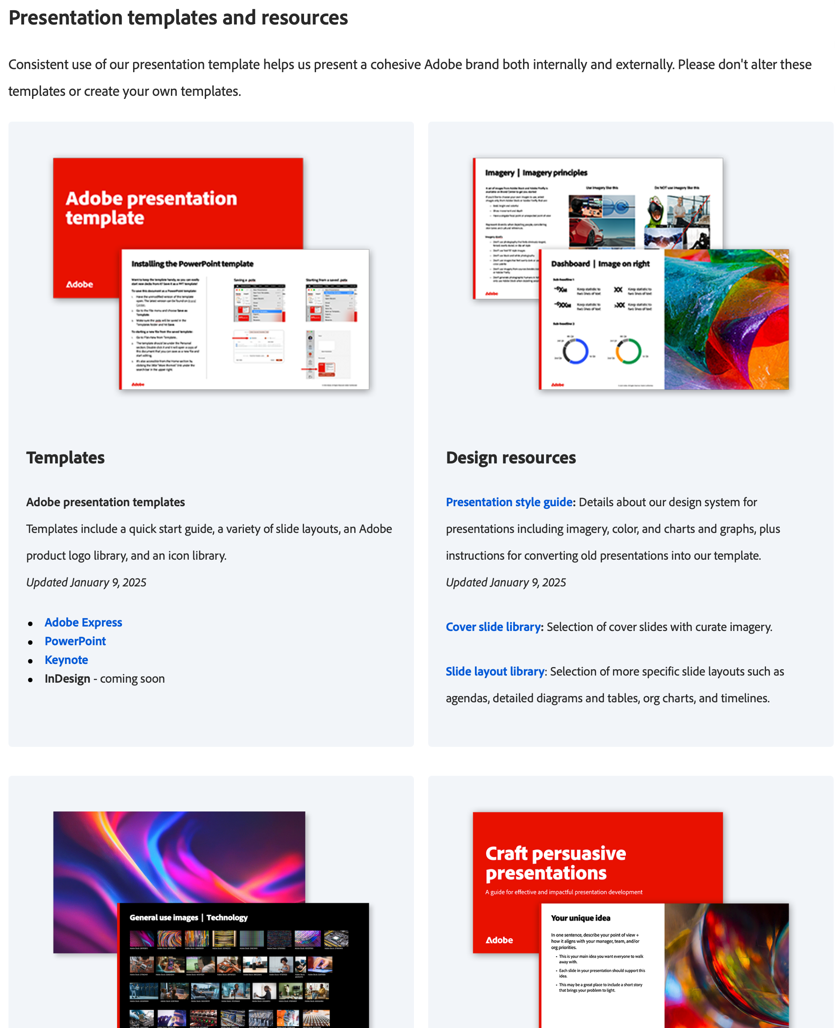

Introduction
Welcome to the Adobe Presentation Template!
Check out Brand Center for all the latest resources and training files to help get you up and running
Also join the new #adobe-presentations channel on Slack to chat about all things presentations and keep up to date on the latest releases of templates and resources.
Creating compelling presentations is a crucial skill across many roles. This guide is designed to help you harness the full potential of our corporate template to communicate your ideas with clarity and professionalism.
Whether you are gearing up for a client presentation, developing a project plan, or eager to present innovative ideas to your stakeholders, the resources and tools provided here will streamline your process and enhance your impact.
Brand Center
#adobe-presentations

Slide 4
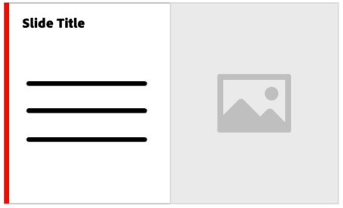









Brand at a glance
Keep it simple, clear & concise
Make sure your message is clear and can be understood quickly.
Layouts
Information laid out in a grid is easier to read. Whitespace is crucial.
Colors
Black, white, and red (#EB1000) are the corporate colors. Use bold, vibrant images to bring other color into your layouts.
Charts
Most datapoints should be shades of gray, with important ones highlighted using the extended color palette.
Font
Always and only use Adobe Clean. Clean Black is for headlines, Clean Regular is for text, Clean Bold is for bolding key terms (use sparingly).
Imagery
Use bold, optimistic, relevant, and inclusive photos.
Use images from the image library.
Icons
Only use Adobe’s icon set.
Icons are only black or white, never colored
Use product logos
Use the official product logos to represent our products and spell the name out next to it in editable text. Don’t use lockups with baked-in text.
Don’t alter our corporate marks
Don’t recolor or otherwise alter the any Adobe marks.
Don’t alter the red thread
The red stripe (thread) on the left side is an important brand element, not to be recolored, overlapped, or altered in any way.

Slide 5
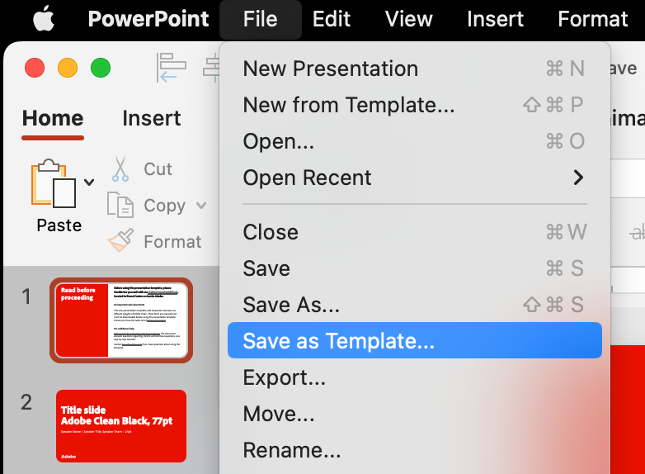
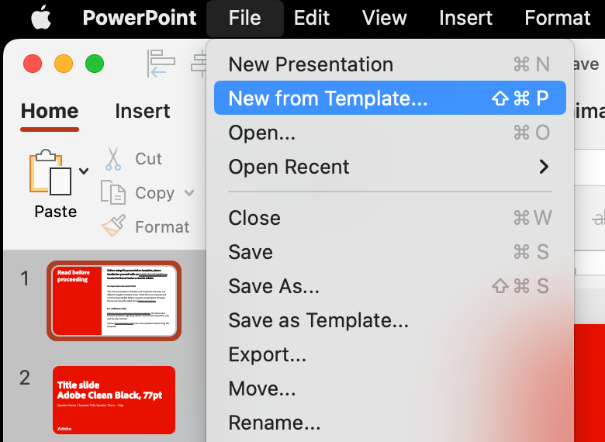
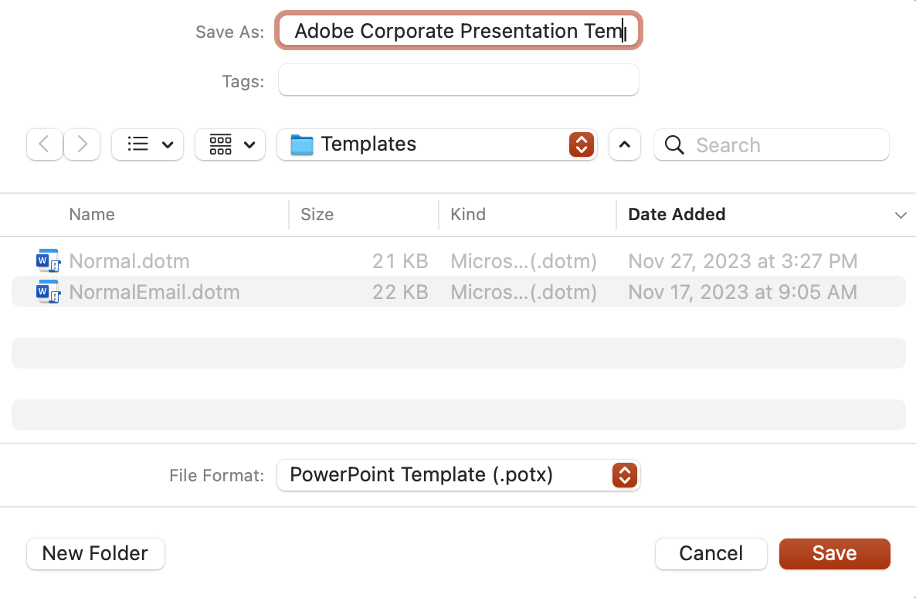
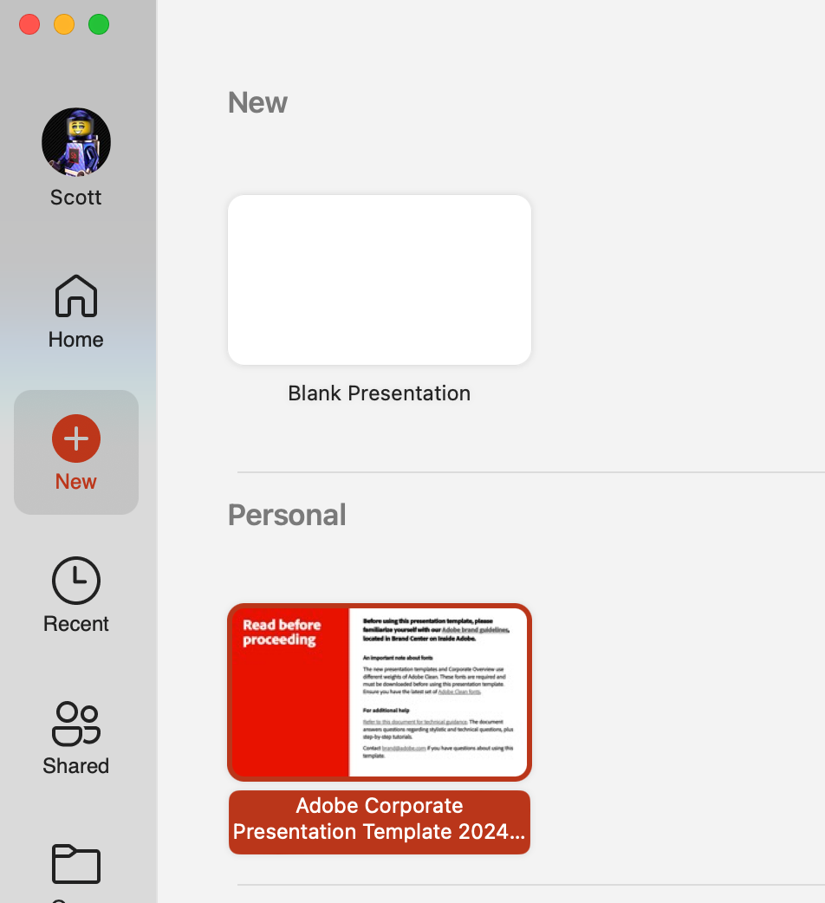
Installing the PowerPoint template
Want to keep the template handy, so you can easily start new decks from it? Save it as a PPT template!
To save this document as a PowerPoint template:
Have the unmodified version of this template open. The latest version can be found on Brand Center.
Go to the File menu and choose Save as Template.
Make sure the .potx will be saved in the Templates folder and hit Save.
To starting a new file from the saved template:
Go to File>New from Template...
The template should be under the Personal section. Double click it and it will open a copy of this document that you can save as a new file and start editing.
It’s also accessible from the Home section by clicking the little “More themes” link under the search bar in the upper right.
Saving a .potx
Starting from a saved .potx

Slide 6
Title slide Adobe Clean Black, 77pt
Speaker Name | Speaker Title, Speaker Team – 24pt

Slide 7
Title slide | Light Adobe Clean Black, 77pt
Speaker Name | Speaker Title, Speaker Team – 24pt

Slide 8

Title slide Image right
Speaker Name – 24pt Speaker Title, Speaker Team – 24pt

Slide 9
Title slide | Dark Adobe Clean Black, 77pt
Speaker Name | Speaker Title, Speaker Team – 24pt

Slide 10
Title slide Image right dark
Speaker Name – 24pt Speaker Title, Speaker Team – 24pt

Slide 11
Section divider | Light

Slide 12
Section divider | Dark

Slide 13
Title and content
Bullet 1 – Adobe Clean, 20pt
Bullet 2 – Adobe Clean, 14pt
Bullet 3 – Adobe Clean, 12pt

Slide 14
Agenda
Speaker Name | Section | Time
John Reese | Analyzing Data in the Field | 9:00a-9:30a
Joss Carter | Governance and Regulations | 9:30a-10:00a
Harold Finch | Data Aggregation via Alt Sources | 10:00a-11:30a
Break |  | 11:30a-12:30p
Carl Elias | Networking and Organization | 12:30p-2:00p
Zoe Morgan | Customer Loyalty | 2:00p-4:00p

Slide 15
Large Quote
“Remove bullet from quote itself.”
Attribution is a second level bullet

Slide 16
Image on right 1/2

Slide 17
Image on right 1/3

Slide 18
Title and content | Dark
Bullet 1 – Adobe Clean, 20pt
Bullet 2 – Adobe Clean, 14pt
Bullet 3 – Adobe Clean, 12pt
Keep text to a minimum on a black background

Slide 19
Large Quote – Dark
“Remove bullet from quote itself.”
Attribution is a second level bullet

Slide 20
Image on right 1/2 | Dark

Slide 21
Image on right 1/3 | Dark

Slide 22
Buckets | Light

Slide 23
Title and content, 2 columns (text)
Bullet 1
Bullet 2
Bullet 3
Bullet 1
Bullet 2
Bullet 3

Slide 24
Title and content, 3 columns (text)
Bullet 1
Bullet 2
Bullet 3
Bullet 1
Bullet 2
Bullet 3
Bullet 1
Bullet 2
Bullet 3

Slide 25
Title and content, 4 columns (text)
Bullet 1
Bullet 2
Bullet 3
Bullet 1
Bullet 2
Bullet 3
Bullet 1
Bullet 2
Bullet 3
Bullet 1
Bullet 2
Bullet 3

Slide 26
Title and content, 5 columns (text)
Bullet 1
Bullet 2
Bullet 3
Bullet 1
Bullet 2
Bullet 3
Bullet 1
Bullet 2
Bullet 3
Bullet 1
Bullet 2
Bullet 3
Bullet 1
Bullet 2
Bullet 3

Slide 27
Title and content, 2 columns (text + images)
Bullet 1
Bullet 2
Bullet 3
Bullet 1
Bullet 2
Bullet 3

Slide 28
Title and content, 3 columns (text + images)
Bullet 1
Bullet 2
Bullet 3
Bullet 1
Bullet 2
Bullet 3
Bullet 1
Bullet 2
Bullet 3

Slide 29
Title and content, 4 columns (text + images)
Bullet 1
Bullet 2
Bullet 3
Bullet 1
Bullet 2
Bullet 3
Bullet 1
Bullet 2
Bullet 3
Bullet 1
Bullet 2
Bullet 3

Slide 30
Title and content, 5 columns (text + images)
Bullet 1
Bullet 2
Bullet 3
Bullet 1
Bullet 2
Bullet 3
Bullet 1
Bullet 2
Bullet 3
Bullet 1
Bullet 2
Bullet 3
Bullet 1
Bullet 2
Bullet 3

Slide 31
Title and content, 2 columns (image + title)
Column 1 title
Column 2 title

Slide 32
Title and content, 3 columns (image + title)
Column 1 title
Column 2 title
Column 3 title

Slide 33
Title and content, 4 columns (image + title)
Column 1 title
Column 2 title
Column 3 title
Column 4 title

Slide 34
Title and content, 5 columns (image + title)
Column 1 title
Column 2 title
Column 3 title
Column 4 title
Column 5 title

Slide 35
Buckets | Dark

Slide 36
Title and content, 2 columns (text) | Dark
Bullet 1
Bullet 2
Bullet 3
Keep text to a minimum on a black background
Bullet 1
Bullet 2
Bullet 3

Slide 37
Title and content, 3 columns (text) | dark
Bullet 1
Bullet 2
Bullet 3
Keep text to a minimum on a black background
Bullet 1
Bullet 2
Bullet 3
Bullet 1
Bullet 2
Bullet 3

Slide 38
Title and content, 4 columns (text) | dark
Bullet 1
Bullet 2
Bullet 3
Keep text to a minimum on a black background
Bullet 1
Bullet 2
Bullet 3
Bullet 1
Bullet 2
Bullet 3
Bullet 1
Bullet 2
Bullet 3

Slide 39
Title and content, 5 columns (text) | dark
Bullet 1
Bullet 2
Bullet 3
Keep text to a minimum on a black background
Bullet 1
Bullet 2
Bullet 3
Bullet 1
Bullet 2
Bullet 3
Bullet 1
Bullet 2
Bullet 3
Bullet 1
Bullet 2
Bullet 3

Slide 40
Title and content, 2 columns (text + images) | Dark
Bullet 1
Bullet 2
Bullet 3
Bullet 1
Bullet 2
Bullet 3

Slide 41
Title and content, 3 columns (text + images) | Dark
Bullet 1
Bullet 2
Bullet 3
Bullet 1
Bullet 2
Bullet 3
Bullet 1
Bullet 2
Bullet 3

Slide 42
Title and content, 4 columns (text + images) | Dark
Bullet 1
Bullet 2
Bullet 3
Bullet 1
Bullet 2
Bullet 3
Bullet 1
Bullet 2
Bullet 3
Bullet 1
Bullet 2
Bullet 3

Slide 43
Title and content, 5 columns (text + images) | Dark
Bullet 1
Bullet 2
Bullet 3
Bullet 1
Bullet 2
Bullet 3
Bullet 1
Bullet 2
Bullet 3
Bullet 1
Bullet 2
Bullet 3
Bullet 1
Bullet 2
Bullet 3

Slide 44
Title and content, 2 columns (image + title) | Dark
Column 1 title
Column 2 title

Slide 45
Title and content, 3 columns (image + title) | Dark
Column 1 title
Column 2 title
Column 3 title

Slide 46
Title and content, 4 columns (image + title) | Dark
Column 1 title
Column 2 title
Column 3 title
Column 4 title

Slide 47
Title and content, 5 columns (image + title) | Dark
Column 1 title
Column 2 title
Column 3 title
Column 4 title
Column 5 title

Slide 48
Image grids

Slide 49
1 x 1 image only

Slide 50

2 x 2 images only

Slide 51
3 x 2 images only

Slide 52
8 x 4 images only

Slide 53
1 x 1 image only – dark

Slide 54
2 x 2 images only – dark

Slide 55
3 x 2 images only – dark

Slide 56
8 x 4 images only | Dark

Slide 57
Full bleed image with red thread

Slide 58
Icons

Slide 59

































































































































Dark icons for white backgrounds
Alerts & actions
Cursors & UI
Arrows
Devices
Art & media
Files & Cloud
Charts & dataviz
Generative
Commerce
Location & time
Communications
Users
Concepts
Web

Slide 60

































































































































Light icons for dark backgrounds
Alerts & actions
Cursors & UI
Arrows
Devices
Art & media
Files & Cloud
Charts & dataviz
Generative
Commerce
Location & time
Communications
Users
Concepts
Web

Slide 61















































Adobe cloud and product icons
Corporate
Cloud
Adobe Creative Cloud
Adobe Document Cloud
Adobe Experience Cloud
Adobe Express
Adobe Firefly
Adobe Acrobat Reader/Standard/Pro
Adobe Acrobat Classic
Content, commerce, and workflows
Adobe Experience Manager
Adobe Commerce
Adobe Workfront
Adobe GenStudio for Performance Marketing
Adobe Photoshop
Adobe Photoshop Express
Adobe Photoshop Camera
Adobe Photoshop Lightroom
Adobe Photoshop Lightroom Classic
Adobe Fresco
Adobe Acrobat Sign
Adobe Scan
Customer journeys
Adobe Journey Optimizer
Adobe Marketo Engage
Adobe Target
Adobe Campaign
Applications and platforms
Adobe Premiere Pro
Adobe After Effects
Adobe Audition
Adobe Animate
Adobe Character Animator
Adobe Premiere Rush
Adobe Media Encoder
Frame.io
Data insights and audiences
Adobe Analytics
Adobe Customer Journey Analytics
Adobe Real-Time CDP
Adobe Mix Modeler
Adobe Illustrator
Adobe InDesign
Adobe InCopy
Adobe Dreamweaver
Adobe XD
Adobe Substance 3D
Adobe Substance 3D Modeler
Adobe Substance 3D Sampler
Adobe Substance 3D Designer
Adobe Substance 3D Painter
Adobe Substance 3D Stager
Adobe Substance 3D Assets
Adobe Aero
Adobe Experience Platform
Adobe Stock
Behance
Adobe Bridge
Adobe Capture
Adobe Portfolio
Adobe Fonts
Adobe Content Authenticity
Adobe Workfront

Slide 62
Closer Slide

